Slide 1

Mike Stokes, 23rd March 2021

Slide 2
EU Exit – The Current State Of Play
We left the EU on 31/01/2020
The 11 months transition period ended on 31/12/2020
We left the single market and the EU customs union
Trade deal agreed with the 27 countries of the EU
Trade deals completed with over 60 non-EU countries
“GSP” arrangement covers 71 developing nations
Deals in place with over 160 countries around the world

Slide 3
UK TRADE AGREEMENTS - MARCH 2021
TRADE AGREEMENT IN PLACE (EU) |  |  |  | TRADE AGREEMENT IN PLACE (Rest of the World) |  |  |  |  | AGREEMENTS TO BE COMPLETED (Imminent)
Austria |  |  |  | Antigua & Barbuda | Lesotho |  |  |  | Canada - preferential duties already in place
Belgium |  |  |  | Bahamas | Liechtenstein |  |  |  | Jordan
Bulgaria |  |  |  | Barbados | Mauritius |  |  |  | Mexico - preferential duties already in place
Croatia |  |  |  | Belize | Moldova
Cyprus |  |  |  | Botswana | Morocco |  |  |  | AGREEMENTS TO BE COMPLETED (Ongoing)
Czech Republic |  |  |  | Cameroon | Mozambique |  |  |  | Albania
Denmark |  |  |  | Chile | Namibia |  |  |  | Algeria
Estonia |  |  |  | Colombia | Nicaragua |  |  |  | Bosnia & Herzegovina
Finland |  |  |  | Costa Rica | North Macedonia |  |  |  | Montenegro
France |  |  |  | Cote d'Ivoire | Norway |  |  |  | Serbia
Germany |  |  |  | Dominica | Palestinian Authority
Greece |  |  |  | Dominican Republic | Panama |  |  |  | MUTUAL RECOGNITION AGREEMENTS
Hungary |  |  |  | Ecuador | Papua New Guinea |  |  |  | Australia
Ireland |  |  |  | Egypt | Peru |  |  |  | New Zealand
Italy |  |  |  | El Salvador | Samoa |  |  |  | USA
Latvia |  |  |  | Eswatini | Seychelles
Lithuania |  |  |  | Faroe Islands | Singapore |  |  |  | GENERAL SYSTEM of PREFERENCE
Luxembourg |  |  |  | Fiji | Solomon Islands |  |  |  | Very preferential or zero rates of import duty
Malta |  |  |  | Georgia | South Africa |  |  |  | 71 developing countries, including
Netherlands |  |  |  | Ghana | South Korea |  |  |  | Bangladesh
Poland |  |  |  | Grenada | St.Kitts & Nevis |  |  |  | Bolivia
Portugal |  |  |  | Guatemala | St. Vincent & Grenadines |  |  |  | Cambodia
Romania |  |  |  | Guyana | St.Lucia |  |  |  | Ethiopia
Slovakia |  |  |  | Honduras | Switzerland |  |  |  | India
Slovenia |  |  |  | Iceland | Trinidad & Tobago |  |  |  | Nigeria
Spain |  |  |  | Israel | Tunisia |  |  |  | Pakistan
Sweden |  |  |  | Jamaica | Turkey |  |  |  | Philippines
 |  |  |  | Japan | Ukraine |  |  |  | Sri Lanka
 |  |  |  | Kenya | Vietnam |  |  |  | Tanzania
 |  |  |  | Kosovo | Zimbabwe |  |  |  | Uganda
 |  |  |  | Lebanon |  |  |  |  | Uzbekistan

Slide 4

What Changed in January?

Slide 5
What Changed in January?
Customs Declarations, Safety & Security Declarations are now required
EORI numbers are required for all declarations
Export Health Certificates needed for export of live animals & animal products
Phytosanitary Certificates needed for export of plants
Some other sector-specific Certificates and Licences are required
UK Border Controls have been introduced in 3 stages
EU Border Controls have been introduced in 1 stage

Slide 6
Northern Ireland Protocol
Came into force on 1st January 2021
Northern Ireland remains part of the UK customs territory
NI’s trade with the Irish Republic (and therefore the rest of the EU)
is also covered by the EU’s customs code
NI applies some single market rules to avoid a regulatory border
“Unfettered Access” for NI businesses selling into the British market
Businesses trading between NI and GB require XI EORI numbers
“Trader Support Service” set up to facilitate trading with NI

Slide 7
What Changed in January?
No duty on most imports and exports between the UK and the EU
Zero duty only applies if goods satisfy Rules Of Origin
Import VAT levied on all imports (EU and Rest of the World)
Postponed Import VAT Accounting scheme introduced
Responsibility for customs clearance (customs declaration, import duties, import VAT) determined by Incoterms used
Really important to understand Rules Of Origin and Incoterms
Vital to double-check data with suppliers, customers and carriers

Slide 8
What Changed in January?
EU nationals have until June to obtain “settled status”
UK’s new Immigration Laws have come into force
Passports must have at least 6 months to run
No visas or work permits required – unless more than
90 days out of 180 are spent in the EU
EHIC fine until expiry date, then GHIC will apply
No meat or dairy products to be taken into the EU
Customs declarations necessary if taking commercial goods

Slide 9
What Changed in January?
VAT changes (export)

Slide 10
Value Added Tax
SALES TO EU UP UNTIL 31st DECEMBER 2020
B2B Goods Zero (must quote customer VAT no. on invoice)
B2B Services Zero (must quote customer VAT no. on invoice)
B2C Goods UK rate of VAT
B2C Services UK rate of VAT (some exceptions)
B2C Digital Services Local rate of VAT (need to register locally or for VAT MOSS)
SALES TO EU FROM 1st JANUARY 2021
B2B Goods Zero
B2B Services Zero
B2C Goods (non DDP) Zero
B2C Goods (DDP) Local rate of VAT
B2C Services Zero (some exceptions)
B2C Digital Services Local rate of VAT (need to register locally or for VAT MOSS)

Slide 11
What Changed in January?
VAT changes (export)
VAT now levied on all imports from the EU
Agreements, Contracts, Ts & Cs
Intellectual Property
Data Protection
ISPM15 regulation for wooden packaging
UKCA Marking

Slide 12
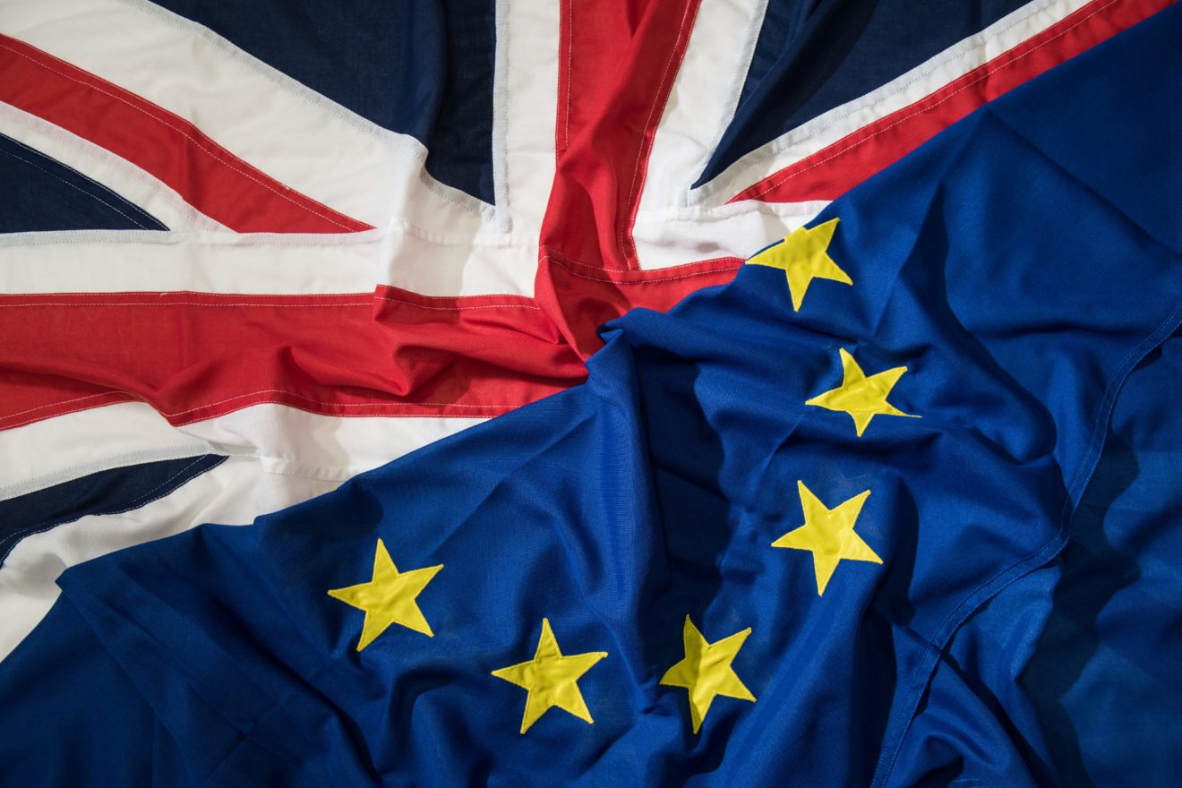
Ten Post-Brexit Issues

Slide 13
Ten Post-Brexit Issues
Didn’t know they had to complete Customs Declarations
Didn’t understand implication of Incoterms
Didn’t understand importance of Rules Of Origin
Didn’t know about EHCs and other special documents
Didn’t realise that VAT on EU imports had been introduced
Hadn’t heard of Postponed Import VAT Accounting scheme
Surprised by “Double Duty” and “EU Re-Export Duty” scenarios
Delays at ports, with couriers and in groupage network
HMRC very difficult to contact
Northern Ireland confusion, frustration and anger

Slide 14
Export Opportunities
Export Trade Deals in place with over 90 countries
Increased exports will aid recovery from Covid landscape
“Levelling Up” initiative (Midlands Engine, Northern Powerhouse, South West)
Department for International Trade’s new “Export Growth Plan”
  Additional local advisers
  “Export Academy” training webinars
  “Internationalisation Fund” programme of matched funding support
  More resources, more training and more funding

Slide 15
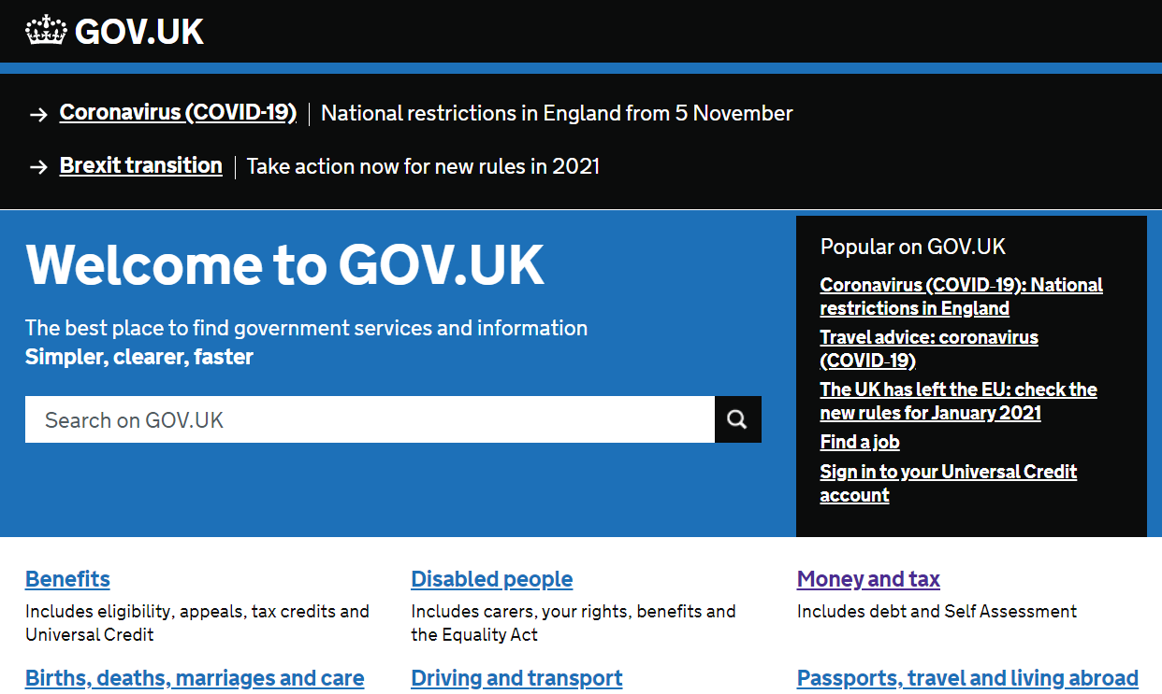
What Support Is There?
Department for International Trade
Local business support teams
Chambers of Commerce, FSB, IOD, IOE and HMRC
Freight Forwarders, Carriers, Hauliers
IP Specialists, GDPR Specialists, Packaging Specialists
Trading Standards
Sector-specific Organisations
GOV.UK website

Slide 16

What Businesses Must Do Now
Confirm EORI numbers & commodity codes
Confirm who is going to complete customs declarations
Review Incoterms and understand Rules Of Origin
Explore Customs Warehouse solution to “Double Duty” issue
Confirm “settled status” of own and UK suppliers’ EU nationals
Consider Duty Deferment accounts and Postponed Import VAT Accounting
Review “European Union” references in all contracts and agreements
Check wooden pallets, crates etc are ISPM15 compliant
Establish if additional EU approvals or certification are required
Start to use UKCA marking and not CE marking for goods sold in the UK

Slide 17
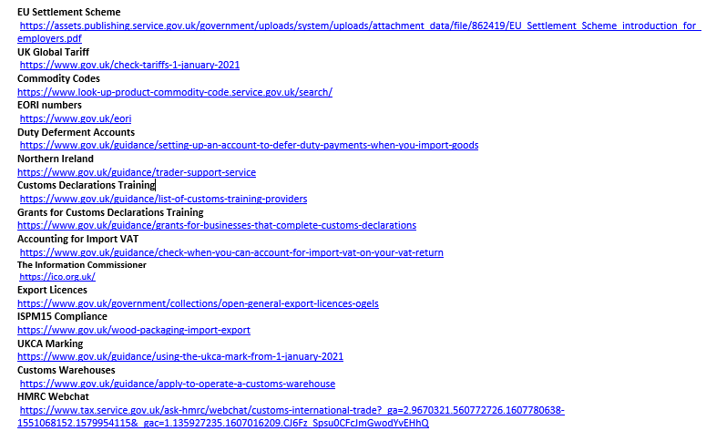
Where Are All the Answers?

Slide 18

Post-Brexit Summary
Teething problems will continue for a while yet
But businesses are getting used to changes
EU remains a vitally important market
New opportunities outside the EU
New Government (DIT) support for exporters
We should look forward with optimism

