Slide 1
‘The UK-EU Trade and Co-operation Agreement (TCA): implications, challenges and next steps’
Prepared by Professor Alex de Ruyter and Mike Stokes

Slide 2
The UK-EU TCA – key aspects
Trade (including economy, social standards, environment and fisheries)
Zero-tariff zero-quota trade agreement for goods that comply with Rules of Origin provisions.
Level playing field provisions in environmental standards, labour standards, social standards, tax regimes and State aid.
Limited market access for road, rail, maritime and air travel between UK and EU including level playing field provisions on passenger rights, worker rights and transport safety.
Framework for joint management of fish stocks in UK and EU waters.
Social security coordination to secure basic reciprocal rights for UK and EU nationals.
Model for energy trading and interconnectivity which includes guarantees for “open and fair competition” and safety standards.
Continued UK participation in certain EU funding programmes (e.g., Horizon 2020) for 2021-27 subject to UK financial contribution to EU budget.

Slide 3
The UK-EU TCA – key aspects
Citizens’ Security
Mutual framework to uphold law enforcement and ensure judicial cooperation in criminal and civil law issues.
Sanctions provisions (suspension of cooperation) if UK violates its commitments to the European Convention of Human Rights and its domestic enforcement thereof.
Protection of personal data.
Governance
Joint Partnership Council to ensure FTA is appropriately applied and interpreted by each side.
Dispute resolution to uphold level playing-field provisions.
Sanctions: both parties can apply cross-sector retaliation if Agreement is violated.
Review of Agreement every four years

Slide 4
Implications
TCA has led to the creation of a new customs regime and an accompanying range of border checks for UK-EU trade.
  Includes NI, which remains in effect in Single Market and Customs Union
TCA excludes services, so implications for eg financial services unilaterally within gift of EU to decide..

Slide 5
Implications
On-going issues (see National Audit Office) re:
  expanding the customs intermediary market;
  developing a solution for roll-on, roll-off (RORO) traffic;
  upscaling customs systems, and;
  determining the requirements for infrastructure to enforce a new compliance regime
Particularly problematic for SMEs….

Slide 6
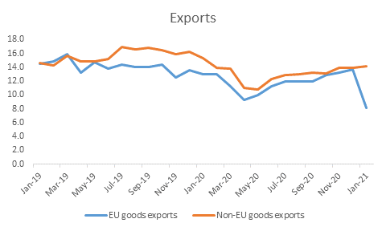
Implications
Source: ONS. UK Trade: January 2021

Slide 7
The Challenges
Clear need for continued, targeted assistance to businesses to overcome the challenges arising from new barriers to trade with the EU.
Are there opportunities for businesses in Yorkshire to take advantage of UK Gov efforts to facilitate increased trade in Indo-Pacific (eg. CPTPP) and North America?

Slide 8
The Challenges
Our own research suggests that more clarity is needed on:
  Logistics and freight-forwarding issues;
  Rules of Origin strictures;
  UKCA Kite-mark
  Issues around data transfer between EU and UK, and:
  Employment of skilled personnel from EU.

Slide 9
Next Steps
TCA imposes cost on both parties from EU Exit, but proportionately greater for the UK.
Need for continued dialogue around NI Protocol; fishing; equivalence for financial services.
Assistance for businesses looking to export outside of EU.

Slide 10
Conclusions
The UK and EU have a TCA, but this is likely to be an unstable equilibrium….
Within the UK, a majority of opinion views EU Exit as a mistake, but key constituencies remain strongly in favour of leaving the EU …
Challenge for the future is: how can the UK mitigate the costs of EU Exit without being a formal EU member?
Political developments in near future may derail current thrust of UK-EU relationship…

Slide 11
EU Exit – The Current State Of Play
We left the EU on 31/01/2020
The 11 months transition period ended on 31/12/2020
We left the single market and the EU customs union
Trade deal agreed with the 27 countries of the EU
Trade deals completed with over 60 non-EU countries
“GSP” arrangement covers 71 developing nations
Deals in place with over 160 countries around the world

Slide 12
UK TRADE AGREEMENTS - MARCH 2021
TRADE AGREEMENT IN PLACE (EU) |  |  |  | TRADE AGREEMENT IN PLACE (Rest of the World) |  |  |  |  | AGREEMENTS TO BE COMPLETED (Imminent)
Austria |  |  |  | Antigua & Barbuda | Lesotho |  |  |  | Canada - preferential duties already in place
Belgium |  |  |  | Bahamas | Liechtenstein |  |  |  | Jordan
Bulgaria |  |  |  | Barbados | Mauritius |  |  |  | Mexico - preferential duties already in place
Croatia |  |  |  | Belize | Moldova
Cyprus |  |  |  | Botswana | Morocco |  |  |  | AGREEMENTS TO BE COMPLETED (Ongoing)
Czech Republic |  |  |  | Cameroon | Mozambique |  |  |  | Albania
Denmark |  |  |  | Chile | Namibia |  |  |  | Algeria
Estonia |  |  |  | Colombia | Nicaragua |  |  |  | Bosnia & Herzegovina
Finland |  |  |  | Costa Rica | North Macedonia |  |  |  | Montenegro
France |  |  |  | Cote d'Ivoire | Norway |  |  |  | Serbia
Germany |  |  |  | Dominica | Palestinian Authority
Greece |  |  |  | Dominican Republic | Panama |  |  |  | MUTUAL RECOGNITION AGREEMENTS
Hungary |  |  |  | Ecuador | Papua New Guinea |  |  |  | Australia
Ireland |  |  |  | Egypt | Peru |  |  |  | New Zealand
Italy |  |  |  | El Salvador | Samoa |  |  |  | USA
Latvia |  |  |  | Eswatini | Seychelles
Lithuania |  |  |  | Faroe Islands | Singapore |  |  |  | GENERAL SYSTEM of PREFERENCE
Luxembourg |  |  |  | Fiji | Solomon Islands |  |  |  | Very preferential or zero rates of import duty
Malta |  |  |  | Georgia | South Africa |  |  |  | 71 developing countries, including
Netherlands |  |  |  | Ghana | South Korea |  |  |  | Bangladesh
Poland |  |  |  | Grenada | St.Kitts & Nevis |  |  |  | Bolivia
Portugal |  |  |  | Guatemala | St. Vincent & Grenadines |  |  |  | Cambodia
Romania |  |  |  | Guyana | St.Lucia |  |  |  | Ethiopia
Slovakia |  |  |  | Honduras | Switzerland |  |  |  | India
Slovenia |  |  |  | Iceland | Trinidad & Tobago |  |  |  | Nigeria
Spain |  |  |  | Israel | Tunisia |  |  |  | Pakistan
Sweden |  |  |  | Jamaica | Turkey |  |  |  | Philippines
 |  |  |  | Japan | Ukraine |  |  |  | Sri Lanka
 |  |  |  | Kenya | Vietnam |  |  |  | Tanzania
 |  |  |  | Kosovo | Zimbabwe |  |  |  | Uganda
 |  |  |  | Lebanon |  |  |  |  | Uzbekistan

Slide 13

What Changed in January?

Slide 14
What Changed in January?
Customs Declarations, Safety & Security Declarations are now required
EORI numbers are required for all declarations
Export Health Certificates needed for export of live animals & animal products
Phytosanitary Certificates needed for export of plants
Some other sector-specific Certificates and Licences are required
UK Border Controls have been introduced in 3 stages
EU Border Controls have been introduced in 1 stage

Slide 15
Northern Ireland Protocol
Came into force on 1st January 2021
Northern Ireland remains part of the UK customs territory
NI’s trade with the Irish Republic (and therefore the rest of the EU)
is also covered by the EU’s customs code
NI applies some single market rules to avoid a regulatory border
“Unfettered Access” for NI businesses selling into the British market
Businesses trading between NI and GB require XI EORI numbers
“Trader Support Service” set up to facilitate trading with NI

Slide 16
What Changed in January?
No duty on most imports and exports between the UK and the EU
Zero duty only applies if goods satisfy Rules Of Origin
Import VAT levied on all imports (EU and Rest of the World)
Postponed Import VAT Accounting scheme introduced
Responsibility for customs clearance (customs declaration, import duties, import VAT) determined by Incoterms used
Really important to understand Rules Of Origin and Incoterms
Vital to double-check data with suppliers, customers and carriers

Slide 17
What Changed in January?
EU nationals have until June to obtain “settled status”
UK’s new Immigration Laws have come into force
Passports must have at least 6 months to run
No visas or work permits required – unless more than
90 days out of 180 are spent in the EU
EHIC fine until expiry date, then GHIC will apply
No meat or dairy products to be taken into the EU
Customs declarations necessary if taking commercial goods

Slide 18
What Changed in January?
VAT changes (export)

Slide 19
Value Added Tax
SALES TO EU UP UNTIL 31st DECEMBER 2020
B2B Goods Zero (must quote customer VAT no. on invoice)
B2B Services Zero (must quote customer VAT no. on invoice)
B2C Goods UK rate of VAT
B2C Services UK rate of VAT (some exceptions)
B2C Digital Services Local rate of VAT (need to register locally or for VAT MOSS)
SALES TO EU FROM 1st JANUARY 2021
B2B Goods Zero
B2B Services Zero
B2C Goods (non DDP) Zero
B2C Goods (DDP) Local rate of VAT
B2C Services Zero (some exceptions)
B2C Digital Services Local rate of VAT (need to register locally or for VAT MOSS)

Slide 20
What Changed in January?
VAT changes (export)
VAT now levied on all imports from the EU
Agreements, Contracts, Ts & Cs
Intellectual Property
Data Protection
ISPM15 regulation for wooden packaging
UKCA Marking

Slide 21
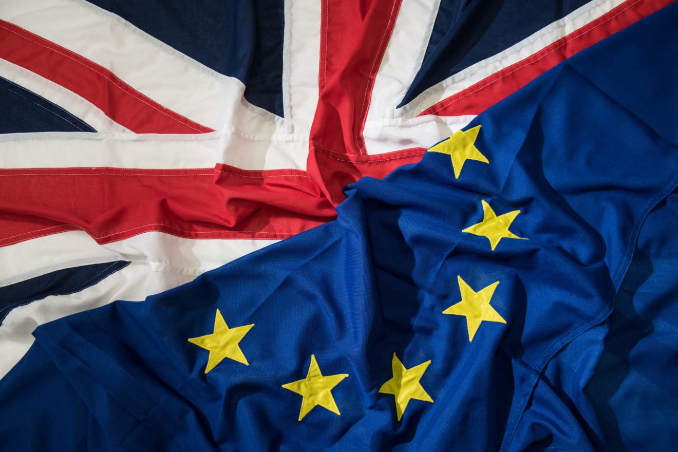
Ten Post-Brexit Issues

Slide 22
Ten Post-Brexit Issues
Didn’t know they had to complete Customs Declarations
Didn’t understand implication of Incoterms
Didn’t understand importance of Rules Of Origin
Didn’t know about EHCs and other special documents
Didn’t realise that VAT on EU imports had been introduced
Hadn’t heard of Postponed Import VAT Accounting scheme
Surprised by “Double Duty” and “EU Re-Export Duty” scenarios
Delays at ports, with couriers and in groupage network
HMRC very difficult to contact
Northern Ireland confusion, frustration and anger

Slide 23
Export Opportunities
Export Trade Deals in place with over 90 countries
Increased exports will aid recovery from Covid landscape
“Levelling Up” initiative (Midlands Engine, Northern Powerhouse, South West)
Department for International Trade’s new “Export Growth Plan”
  Additional local advisers
  “Export Academy” training webinars
  “Internationalisation Fund” programme of matched funding support
  More resources, more training and more funding

Slide 24
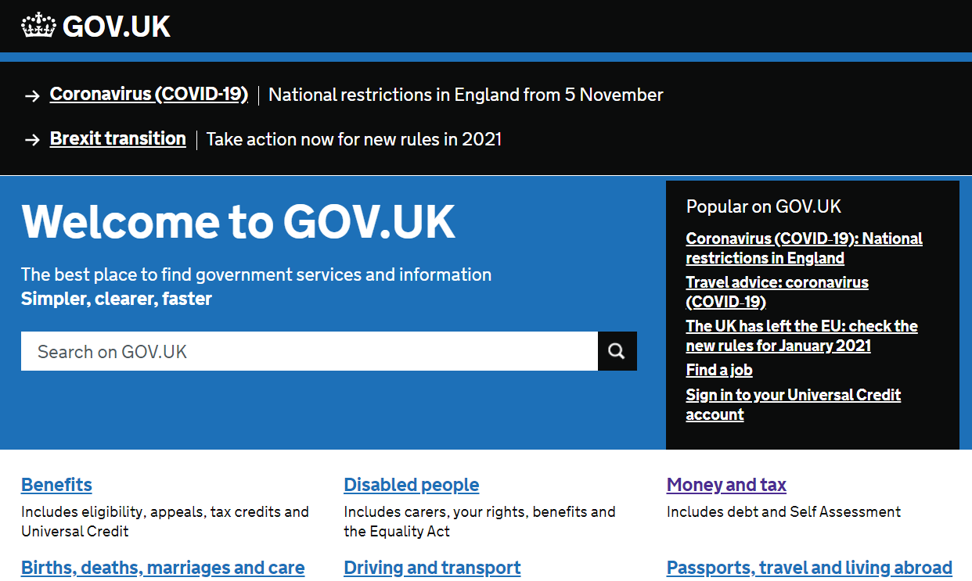
What Support Is There?
Department for International Trade
Local business support teams
Chambers of Commerce, FSB, IOD, IOE and HMRC
Freight Forwarders, Carriers, Hauliers
IP Specialists, GDPR Specialists, Packaging Specialists
Trading Standards
Sector-specific Organisations
GOV.UK website

Slide 25

What Businesses Must Do Now
Confirm EORI numbers & commodity codes
Confirm who is going to complete customs declarations
Review Incoterms and understand Rules Of Origin
Explore Customs Warehouse solution to “Double Duty” issue
Confirm “settled status” of own and UK suppliers’ EU nationals
Consider Duty Deferment accounts and Postponed Import VAT Accounting
Review “European Union” references in all contracts and agreements
Check wooden pallets, crates etc are ISPM15 compliant
Establish if additional EU approvals or certification are required
Start to use UKCA marking and not CE marking for goods sold in the UK

Slide 26
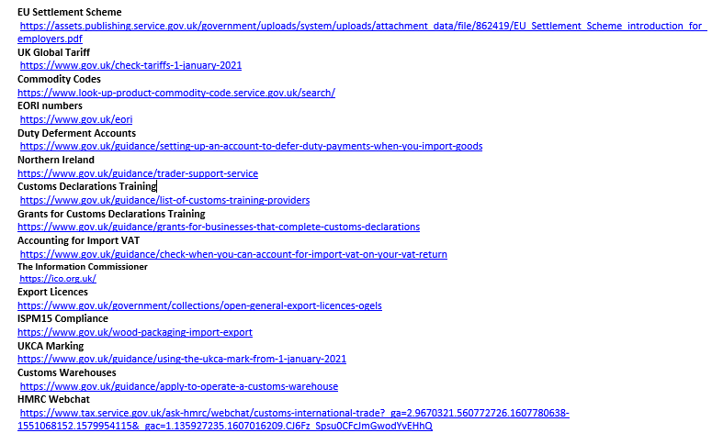
Where Are All the Answers?

Slide 27

Post-Brexit Summary
Teething problems will continue for a while yet
But businesses are getting used to changes
EU remains a vitally important market
New opportunities outside the EU
New Government (DIT) support for exporters
We should look forward with optimism

Slide 28


Thank you.

